Slide 1
Contributing to Django
How I learned to stop worrying and just try to fix an ORM Bug

Slide 2
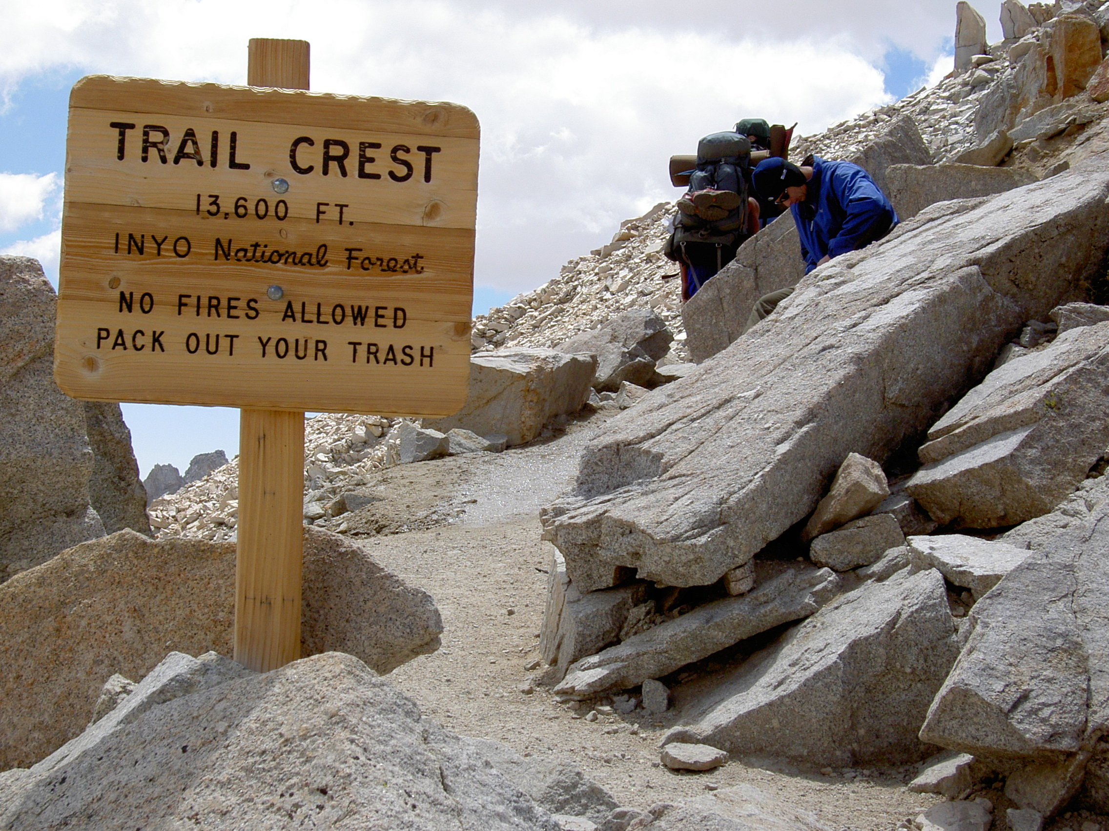
Notes:
# Notes
There I was ... at the top of the Mt Whitney Portal, roughly 13.6 ft (4159 m) above sea level
I had spent the last 7 days hiking to get here.
I was only 3 miles from the summit of Mt Whitney ... but I wasn't sure I could go any further.
My hiking companions told me I didn't look so good. Truth be told, I didn't feel so good either.
Did I make it to the summit?
And what does this story have to do with contributing to Django?

Slide 3
DjangoCon US
Notes:
I’ve been trying to make it to DjangoCon US since 2018

Slide 4
2018
Notes:
But, I had a work conference I had to attend.

Slide 5
2019
Notes:
It happened again in 2019

Slide 6
2020
Notes:
I was *determined* to go in 2020 ... but we all know what happened there

Slide 7
2021
Notes:
I was able to attend the online version in 2021

Slide 8
2022
Notes:
And then I finally made it in person 2022
Picture of DjangoCon that Paulo had of you
And it was amazing.

Slide 9
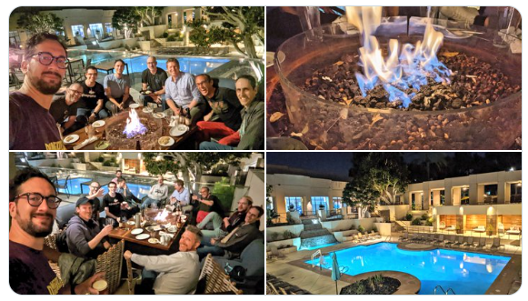

Slide 10
Sprints
Notes:
I was very excited about attending the sprints and working on *something* ORM related
My strategy for finding a ticket was to find something old, that seemed straightforward(ish) and then just go for it.
I spent some time during the conference trying to find something, and by the day of the springs I had been able to narrow it down to a single ticket

Slide 11
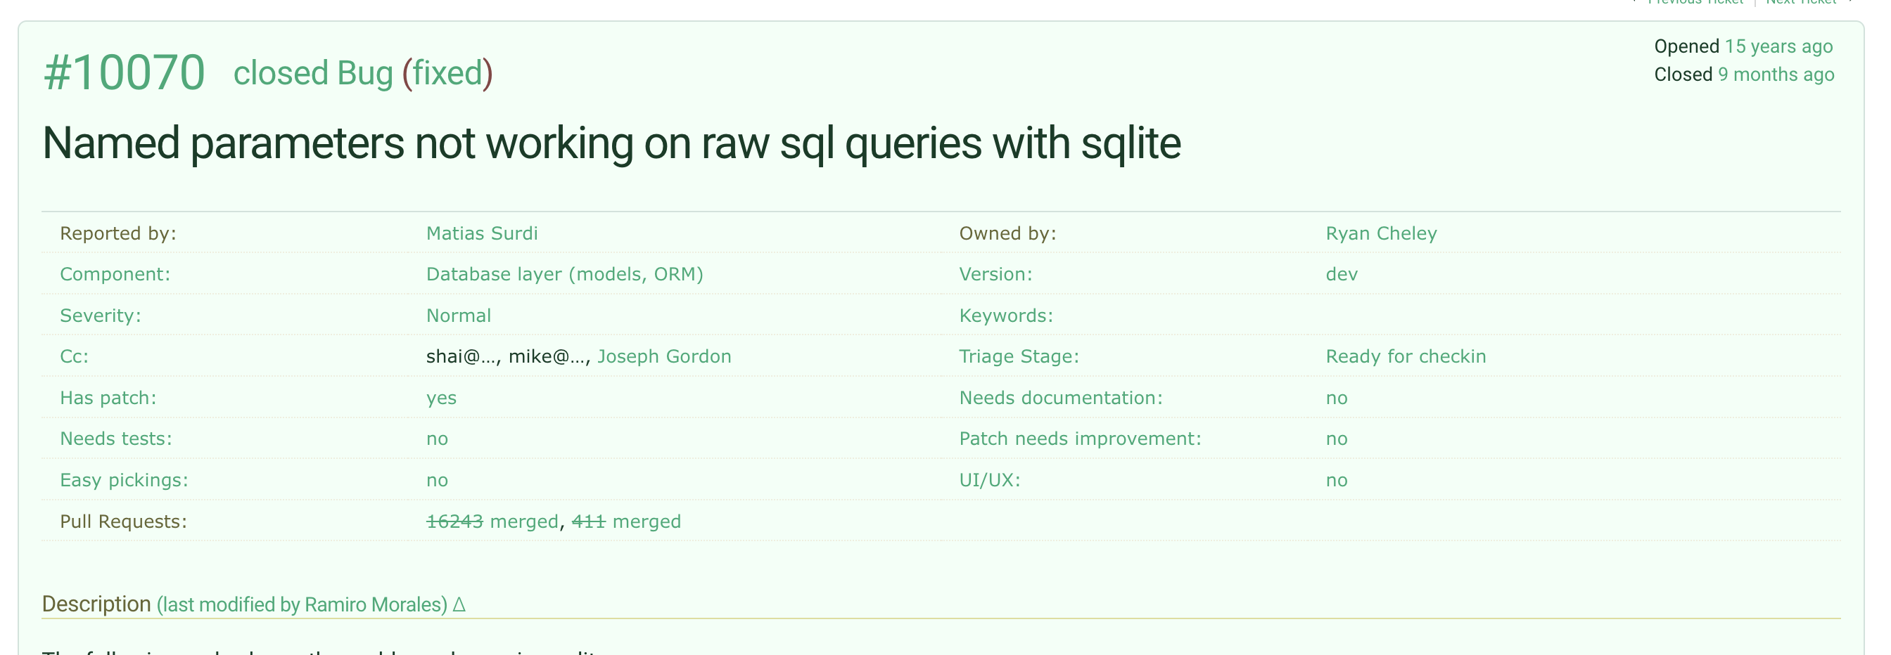

Slide 12
Reviewing the Ticket
Notes:
I spent time reviewing the ticket and then speaking with Simon Charette about it. It seemed as though it wasn't a problem anymore

Slide 13
Marking the Ticket as Done 🎉
Notes:
Marking the Ticket as Done!

Slide 14
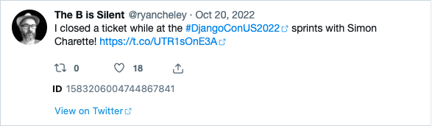
Letting everyone know!
Notes:
I was so excited that I let the world know about it on the bird site

Slide 15
Home
Notes:
And then I headed home having been able to a bug in the ORM as ‘fixed’
….

Slide 16

Notes:
And I felt *really* good about this

Slide 17
But then …

Slide 18
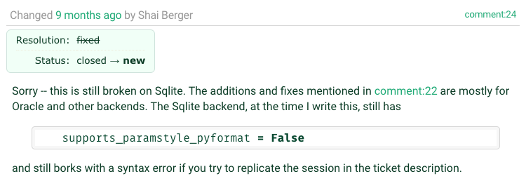

Slide 19
Oh no!
Notes:
I was faced with two potential choices:

Slide 20
Ignore
Notes:
Ignore the bug. It had been a bug for YEARS and didn’t seem to have caused any MAJOR issues

Slide 21
Fix
Notes:
Try to work it on my own
I also had lots of feelings surrounding the discovery of the bug still existing

Slide 22
Embarrassment
Notes:
I tweeted out it
I had people at DjangoCon US 2022 ASK ME HOW I DID IT!

Slide 23
Disappointment
Notes:
Letting people down (whether on not this was actually the case is an entire different discussion perhaps)

Slide 24
Fear
Notes:
Imposter Syndrome – Can I work on this on “my own”

Slide 25
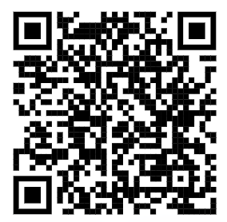
Community
Notes:
Because of a talk that Carlton Gibson gave at DjangoCon US 2018 “Your Framework Needs You”, I decided to give it a shot, even though I would be on my own mostly

Slide 26
Working on the Ticket
Notes:
I went to work on the ticket and did what most of us do when we’re assigned a Bug for work, or on a personal project
Replicate the Bug
Read some docs
Write some code
Test the Code

Slide 27
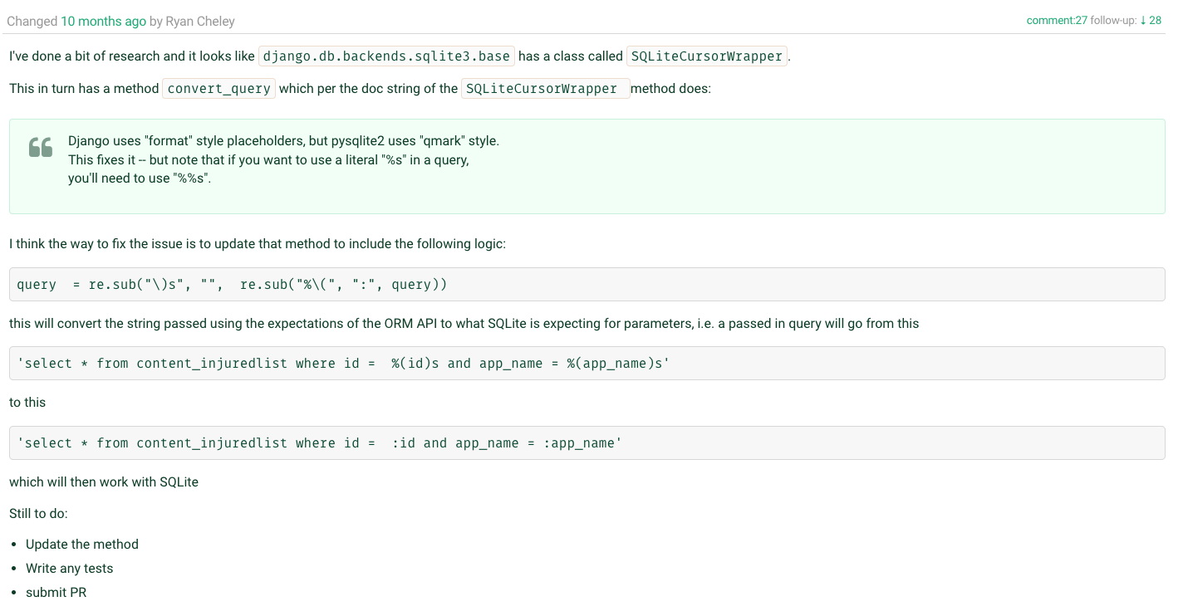

Slide 28
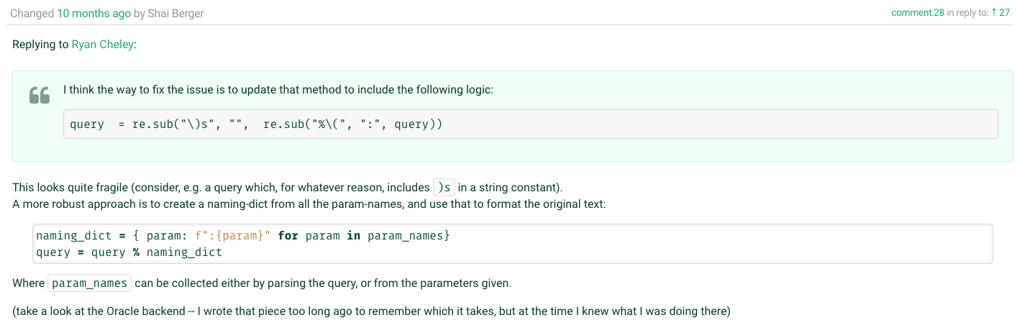

Slide 29
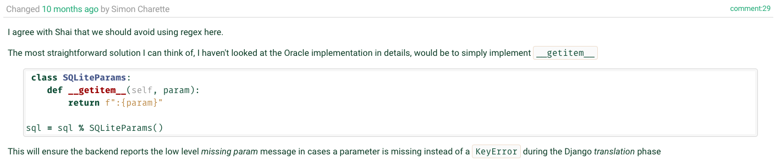

Slide 30
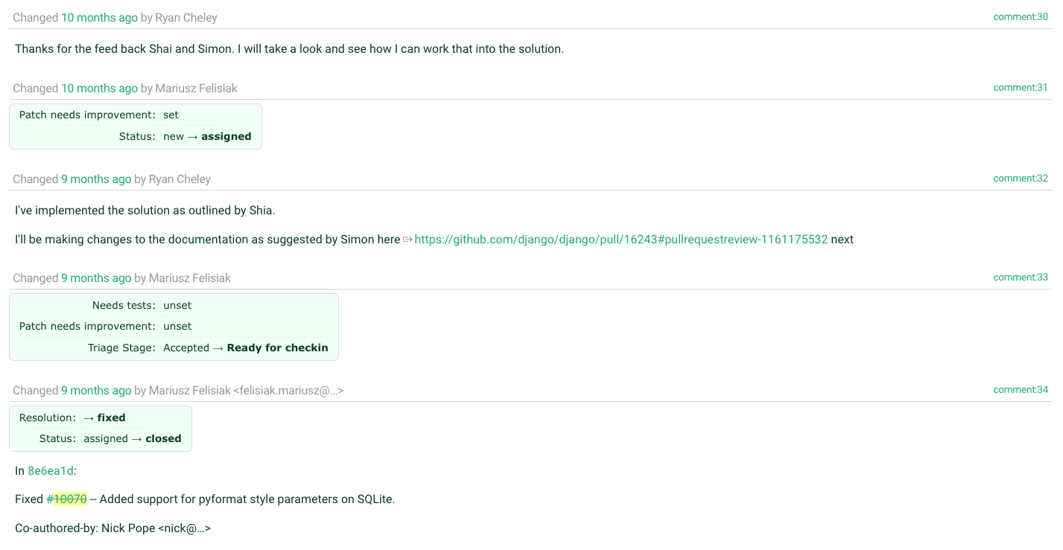

Slide 31
1. Replicate
Notes:
Replicate the Bug

Slide 32
2. Read
Notes:
Read some docs

Slide 33
3. Write
Notes:
Write some code

Slide 34
4. Test
Notes:
Test the code that you wrote

Slide 35
5. Write
Notes:
Write down what you’re learning as you’re learning … because we all do this, right?
I didn’t, until I saw this talk by Simon Willison at DjangoCon US 2022 titled, “Massively increase your productivity on personal projects with comprehensive documentation and automated tests”

Slide 36
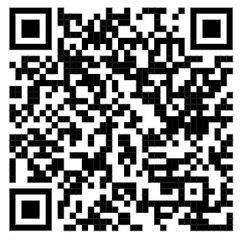
Public Notes
Notes:
At DjangoCon 2022 Simon Willison gave a great talk which included an idea called ‘public notes’. I highly recommend watching that talk and implementing the public notes idea
Essentially you use an issue (in this case a GitHub issue) as a spot to work through a problem and leave yourself bread crumbs for what you’ve tried and learned, basically doing what you would do in the ‘scientific method’

Slide 37
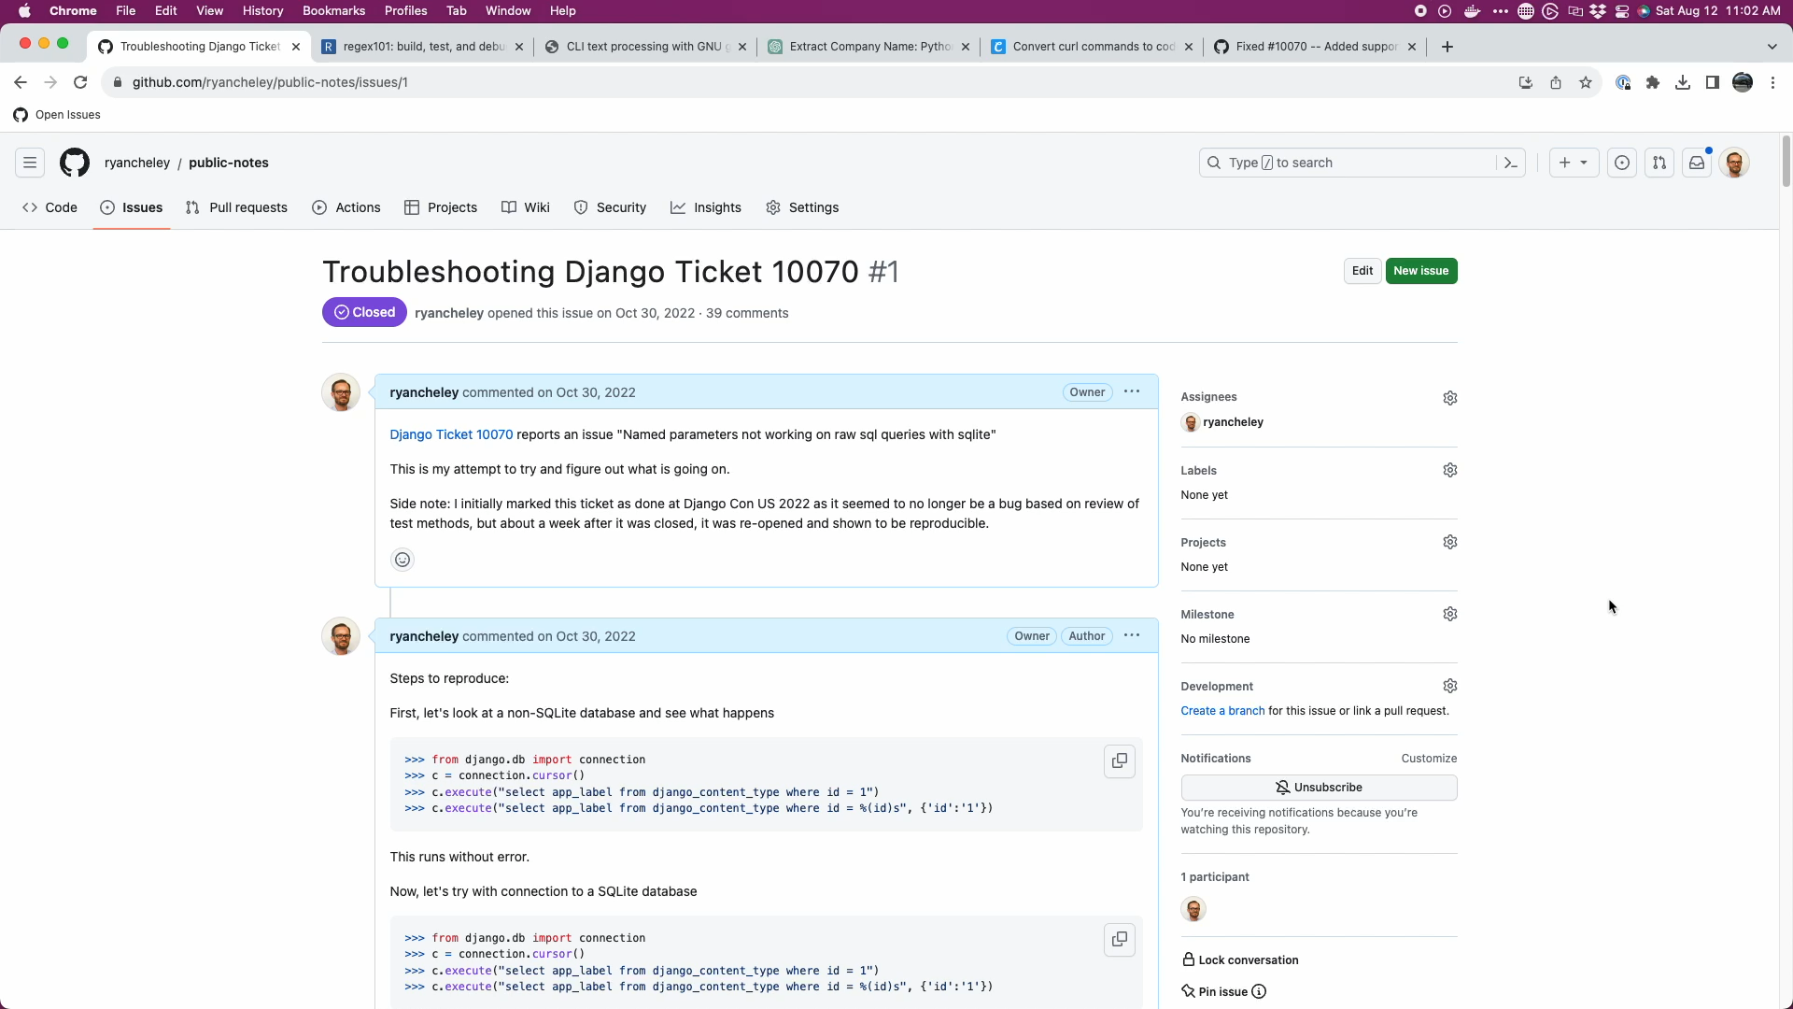

Slide 38
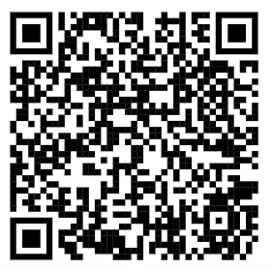
My Public Notes
Notes:
In my notes there’s a lot of back and forth, two steps backward, 1 step forward kind of things, but even looking at it now, I can see my thought process for how the bug ended up getting fixed

Slide 39
The fix
Notes:
Ultimately the fix was made but it wasn’t just *me* that did this. I had a lot of help in getting the code to the right spot.
Nick Pope
Shia Berger
Simon Charette
Mariusz Felisiak

Slide 40

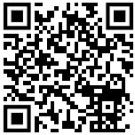
Nick
Notes:
There is duplication which should be pushed down into .convert_query().
Converting %(value)s to :value in this way will also convert %%s to %s which will then be incorrectly converted to ? in .convert_query(). We should not perform both conversions¹ and a test should be added to ensure this doesn't happen.
Converting param_list to a list in .executemany() will saddle us with poor performance. We many have been passed a generator and the current approach will force all of the parameters to be materialized. The approach needed requires that we can peek at the first item in the generator without consuming the lot.

Slide 41
Shia
Notes:
Feedback that the approach had some fragility https://code.djangoproject.com/ticket/10070#comment:28
with Simon Charette agreeing https://code.djangoproject.com/ticket/10070#comment:29
And that regex should be avoided

Slide 42

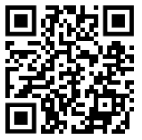
Simon
Notes:
Remember to update the docs!
Also, he gave an awesome primer on the ORM in general at the sprints
And a great keynote at DjangoCon US 2022

Slide 43
Mariusz
Notes:
Need to find something here or take out Mariusz name

Slide 44
Lessons
Notes:
Any time you use the word ‘just’ in a statement, there’s potentially a lot to unpack.
In this room if I say something like “It’s just Assembly” or “It’s just Machine Language” while presenting a solution to a problem, that ‘just’ can turn off a lot of people.
And so I say this with as much kindness as possible given that this is a room full of Djangonauts and Pythonistas

Slide 45
The Django ORM …

Slide 46
Is **just** Python

Slide 47
In fact, all of Django …

Slide 48
Is **just** Python

Slide 49
Looking at Tickets
Notes:
So when you go to look for a ticket to take, remember that there is an amazing community here that wants to see you succeed … and at the end of the day the code

Slide 50
Is **just** Python

Slide 51
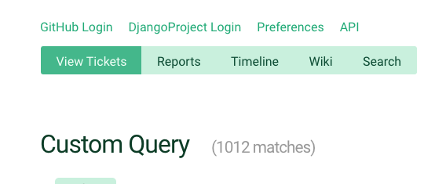
Notes:
So when you’re ready to dive in to one of the currently <> open tickets, just keep that in mind

Slide 52
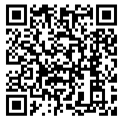
Trac
Notes:
And because this is Django, there is great documentation on how to triage tickets and work through them

Slide 53
Notes:
Back to Mt Whitney
I was **only** three miles from the summit, but I just wasn’t feeling **it**.
My fellow hikers didn’t discourage me from continuing, but they didn’t really encourage me either.
I didn’t make it to the summit that day and it’s been a regret kind of ever since.
But why am I telling this story? What does this have to do with fixing a bug in the Django ORM.
When the bug wasn’t resolved I had an option to just give up.
But the community helped me to work through it. The solution that was ultimately submitted and merged wasn’t just mine, it was through the hard work of a couple of different people.
This community wants you to succeed. They want you to learn.
If this community had been up there with me that day, I’m 100% sure that I would have made it to the summit because of the encouragement that is provided and the determination to want **you** to succeed

Slide 54
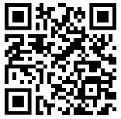
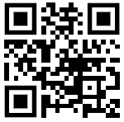
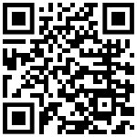
Find me on …
Platform | QR Code
Mastodon https://mastodon.social/@ryancheley
GitHub https://github.com/ryancheley/
LinkedIn https://www.linkedin.com/in/ryan-cheley/

Slide 55
Thank you

